Slide 1
Bioinformatics Nucleic Acid World
Assoc. Prof. Dr. Gazi Erkan BOSTANCI
Slides are mainly based on ‘Understanding Bioinformatics’ by Marketa Zvelebil and Jeremy O. Baum

Slide 2
It is amazing to realize that the full diversity of life on this planet—from the simplest bacterium to the largest mammal—is captured in a linear code inside all living cells.
In almost exactly the way the vivid detail of a musical symphony or a movie can be digitally recorded in a binary code, so the four base units of the DNA molecule capture and control all the complexity of life.
The crucially important discovery of the link between DNA, proteins, and the diversity of life came during the twentieth century and brought about a revolution in the understanding of genetics.

Slide 3
One of the key challenges facing biologists today is to organize, study, and draw conclusions from all this information: the patterns within the sequences and experimental data, the structure and the function of the various types of molecules, and how everything interacts to produce a correctly functioning organism.
Bioinformatics is the name we give to this study and our aim is to use it to obtain greater understanding of living systems.

Slide 4
This chapter will deal with the nucleic acids—deoxyribonucleic acid (DNA) and ribonucleic acid (RNA)—and how they encode proteins, while the structure and functions of proteins themselves will be discussed in next chapter.
In the following two chapters, we shall also discuss how DNA changes its information-coding and functional properties over time as a result of the processes of mutation, giving rise to the enormous diversity of life, and the need for bioinformatics to understand it.

Slide 5
The main role of DNA is information storage. In all living cells, from unicellular bacteria to multicellular plants and animals, DNA is the material in which genetic instructions are stored and is the chemical structure in which these instructions are transmitted from generation to generation.
Incredibly, the information required to reproduce even very complex organisms is stored on a relatively small number of DNA molecules. This set of molecules is called the organism’s genome.
In humans there are just 46 DNA molecules in most cells, one in each chromosome. Each DNA molecule is copied before cell division, and the copies are distributed such that each daughter cell receives a full set of genetic information.

Slide 6
Proteins are manufactured using the information encoded in DNA and are the molecules that direct the actual processes on which life depends. Processes essential to life, such as energy metabolism, biosynthesis, and intercellular communication, are all carried out through the agency of proteins.
A gene is basically the information in DNA that directs the manufacture of a specific protein or RNA molecular form.
As we shall see, however, the organization of genes within the genome and the structure of individual genes are somewhat different in different groups of organisms, although the basic principles by which genes encode information are the same in all living things.

Slide 7
The structure of DNA and RNA
Considering their role as the carrier of genetic information, DNA molecules have a relatively simple chemical structure. They are linear polymers of just four different nucleotide building blocks whose differences are restricted to a substructure called the base.

Slide 8
For efficient encoding of information, one might have expected there to be numerous different bases, but in fact there are only four.
This was one of the reasons why the true role of DNA as the carrier of genetic information was not appreciated until the 1940s, long after the role of the chromosomes in heredity was apparent.
But although chemically simple, genomic DNA molecules are immensely long, containing millions of bases each, and it is the order of these bases, the nucleotide sequence or base sequence of DNA, which encodes the information for making proteins.

Slide 9
The three-dimensional structure of DNA is also relatively simple, involving regular double helices. There are also larger-scale regular structures, but it has been clearly established that the information content of DNA is held at the level of the base sequence itself.
RNA molecules are also linear polymers, but are much smaller than genomic DNA. Most RNA molecules also contain just four different base types.

Slide 10
In DNA only four different bases occur: the purines guanine (G) and adenosine (A) and the pyrimidines cytosine (C) and thymine (T).
In most forms of RNA molecule there are also just four bases, three being the same as in DNA, but thymine is replaced by the pyrimidine uracil (U).

Slide 11
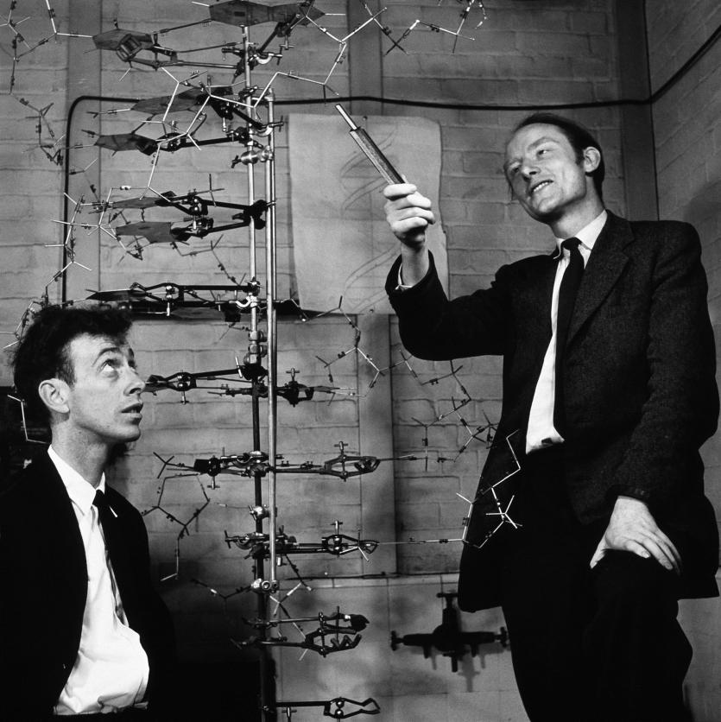
James Watson (left)
Francis Crick

Slide 12
The key discovery for which the Nobel Prize was awarded to James Watson and Francis Crick, who drew on the work of Rosalind Franklin and others was the elucidation in 1953 of the double-helical structure of the DNA molecule.
Two scientists whose work was
influential on James Watson and
Francis Crick when they
elucidated the structure of DNA.
(A) Maurice Wilkins.
(B) Rosalind Franklin.

Slide 13
All the bases are on the inside of the double helix, with the phosphate-linked sugars forming a backbone on the outside.
Crucial to Watson and Crick’s success was their realization that the DNA molecules contained two strands and that the base-pairing follows a certain set of rules, now called Watson–Crick base-pairing, in which a specific purine pairs only with a specific pyrimidine: A with T, and C with G. Each strand of a DNA double helix therefore has a base sequence that is complementary to the base sequence of its partner strand.
The bases interact through hydrogen bonding; two hydrogen bonds are formed in a T–A base pair, and three in a G–C base pair. This complementarity means that if you know the base sequence of one strand of DNA, you can deduce the base sequence of the other.

Slide 15
One of the truly remarkable features of DNA in living systems is how few errors there are in the complementarity of the two strands. The error rate is approximately 1 base in 10⁹.
This is very important, as it is vital to transmit the genome as accurately as possible to subsequent generations.
DNA strands can pair with a DNA or RNA strand of complementary sequence to make a double-stranded DNA or DNA/RNA hybrid. This property forms the basis of a set of powerful experimental molecular biology techniques.

Slide 16
In contrast to DNA, almost all RNA molecules in living systems are single stranded. Because of this, RNA has much more structural flexibility than DNA, and some RNAs can even act as enzymes, catalyzing a particular chemical reaction.

Slide 17
DNA, RNA and Protein: Central Dogma
There is a key relationship between DNA, RNA, and the synthesis of proteins, which is often referred to as the central dogma of molecular biology.
According to this concept, there is essentially a single direction of flow of genetic information from the DNA, which acts as the information store, through RNA molecules from which the information is translated into proteins.

Slide 18
The key concept introduced in this section is that DNA is transcribed into mRNA which is then translated to make protein molecules.

Slide 19
This basic scheme holds for all known forms of life, although there is some variation in the details of the processes involved. The proteins are the main working components of organisms, playing the major role in almost all the key processes of life.
However, not all the genetic information in the DNA encodes proteins. Molecules such as RNA can also be the end product, and other regions of genomes have as yet no known function or product.

Slide 20
All the information needed to build and maintain a human being is contained in just 23 pairs of DNA molecules, comprising the chromosomes of the human genome.
These molecules are amongst the largest and longest known, the smallest having 47 million bases and the largest 247 million bases, with the entire human genome being composed of approximately 3 billion bases.

Slide 21
The DNA of each chromosome encodes hundreds to thousands of proteins, depending on the chromosome, each protein being specified by a distinct segment of DNA.
In simple terms, this segment is the gene for that protein. In practice, a gene is considered also to include surrounding regions of noncoding DNA that act as control regions.

Slide 22
DNA is the information store, but RNA is the messenger
The information encoded in DNA is expressed through the synthesis of other molecules; it directs the formation of RNA and proteins with specific sequences.
As is described in detail in next lecture, proteins are linear polymers composed of another set of chemical building blocks, the amino acids. There are some 20 different amino acids in proteins, and their varied chemistry.

Slide 23
The sequence of bases in the DNA of a gene specifies the sequence of amino acids in a protein chain. The conversion does not occur directly, however. After a signal to switch on a gene is received, a single-stranded RNA copy of the gene is first made in a process called transcription.
Transcription is essentially similar to the process of DNA replication, except that only one of the DNA strands acts as a template in this case, and the product is RNA not DNA.
RNA synthesis is catalyzed by enzymes called RNA polymerases, which, like DNA polymerases, move along the template, matching incoming ribonucleotides to the bases in the template strand and joining them together to make an RNA chain.

Slide 24
Only the relevant region of DNA is transcribed into RNA, therefore the RNA is a much smaller molecule than the DNA it comes from. So while the DNA carries information about many proteins, the RNA carries information from just one part of the DNA, usually information for a single protein.
RNA transcribed from a protein-coding gene is called Messenger RNA (mRNA) and it is this molecule that directs the synthesis of the protein chain in the process called translation.
When a gene is being transcribed into RNA, which is in turn directing protein synthesis, the gene is said to be expressed. Expression of many genes in a cell or a set of cells can be measured using DNA or RNA expression microarrays.

Slide 25
Only one of the DNA strands in any given gene is transcribed into RNA. As the RNA must have a coding sequence that can be correctly translated into protein, the DNA strand that acts as the physical template for RNA synthesis does not carry the coding sequence itself, but its complement. It is therefore known as the noncoding strand or anticoding or antisense strand.
The sequence of the other, non-template DNA strand is identical to that of the messenger RNA (with T replacing U), and this strand is called the coding or sense strand. This is the DNA sequence that is written out to represent a gene, and from which the protein sequence can be deduced according to the rules of the genetic code.

Slide 26
Transcription.
(A) One strand of the DNA is involved in the synthesis of an RNA strand complementary to the strand of the DNA.
(B) The enzyme RNA polymerase is involved in the transcription process. It reads the DNA and recruits the correct building blocks of RNA to string them together based on the DNA code.

Slide 27
Although only one segment of the DNA strand is transcribed for any given gene, it is also possible for genes to overlap so that one or both strands at the same location encode parts of different proteins.
This most commonly occurs in viruses as a means of packing as much information as possible into a very small genome.
However, overlapping genes can also occur in mammals; recently 774 pairs of overlapping genes were identified in the human genome.

Slide 28
Messenger RNA is translated into protein according to the genetic code
The genetic code refers to the rules governing the correspondence of the base sequence in DNA or RNA to the amino acid sequence of a protein. The essential problem is how a code of four different bases in nucleic acids can specify proteins made up of 20 different types of amino acids.
The solution is that each amino acid is encoded by a set of three consecutive bases. The three-base sets in RNA are called codons, and genetic code tables conventionally give the genetic code in terms of RNA codons.

Slide 29
Standard genetic code.
The corresponding amino acid is given next to each codon.

Slide 30
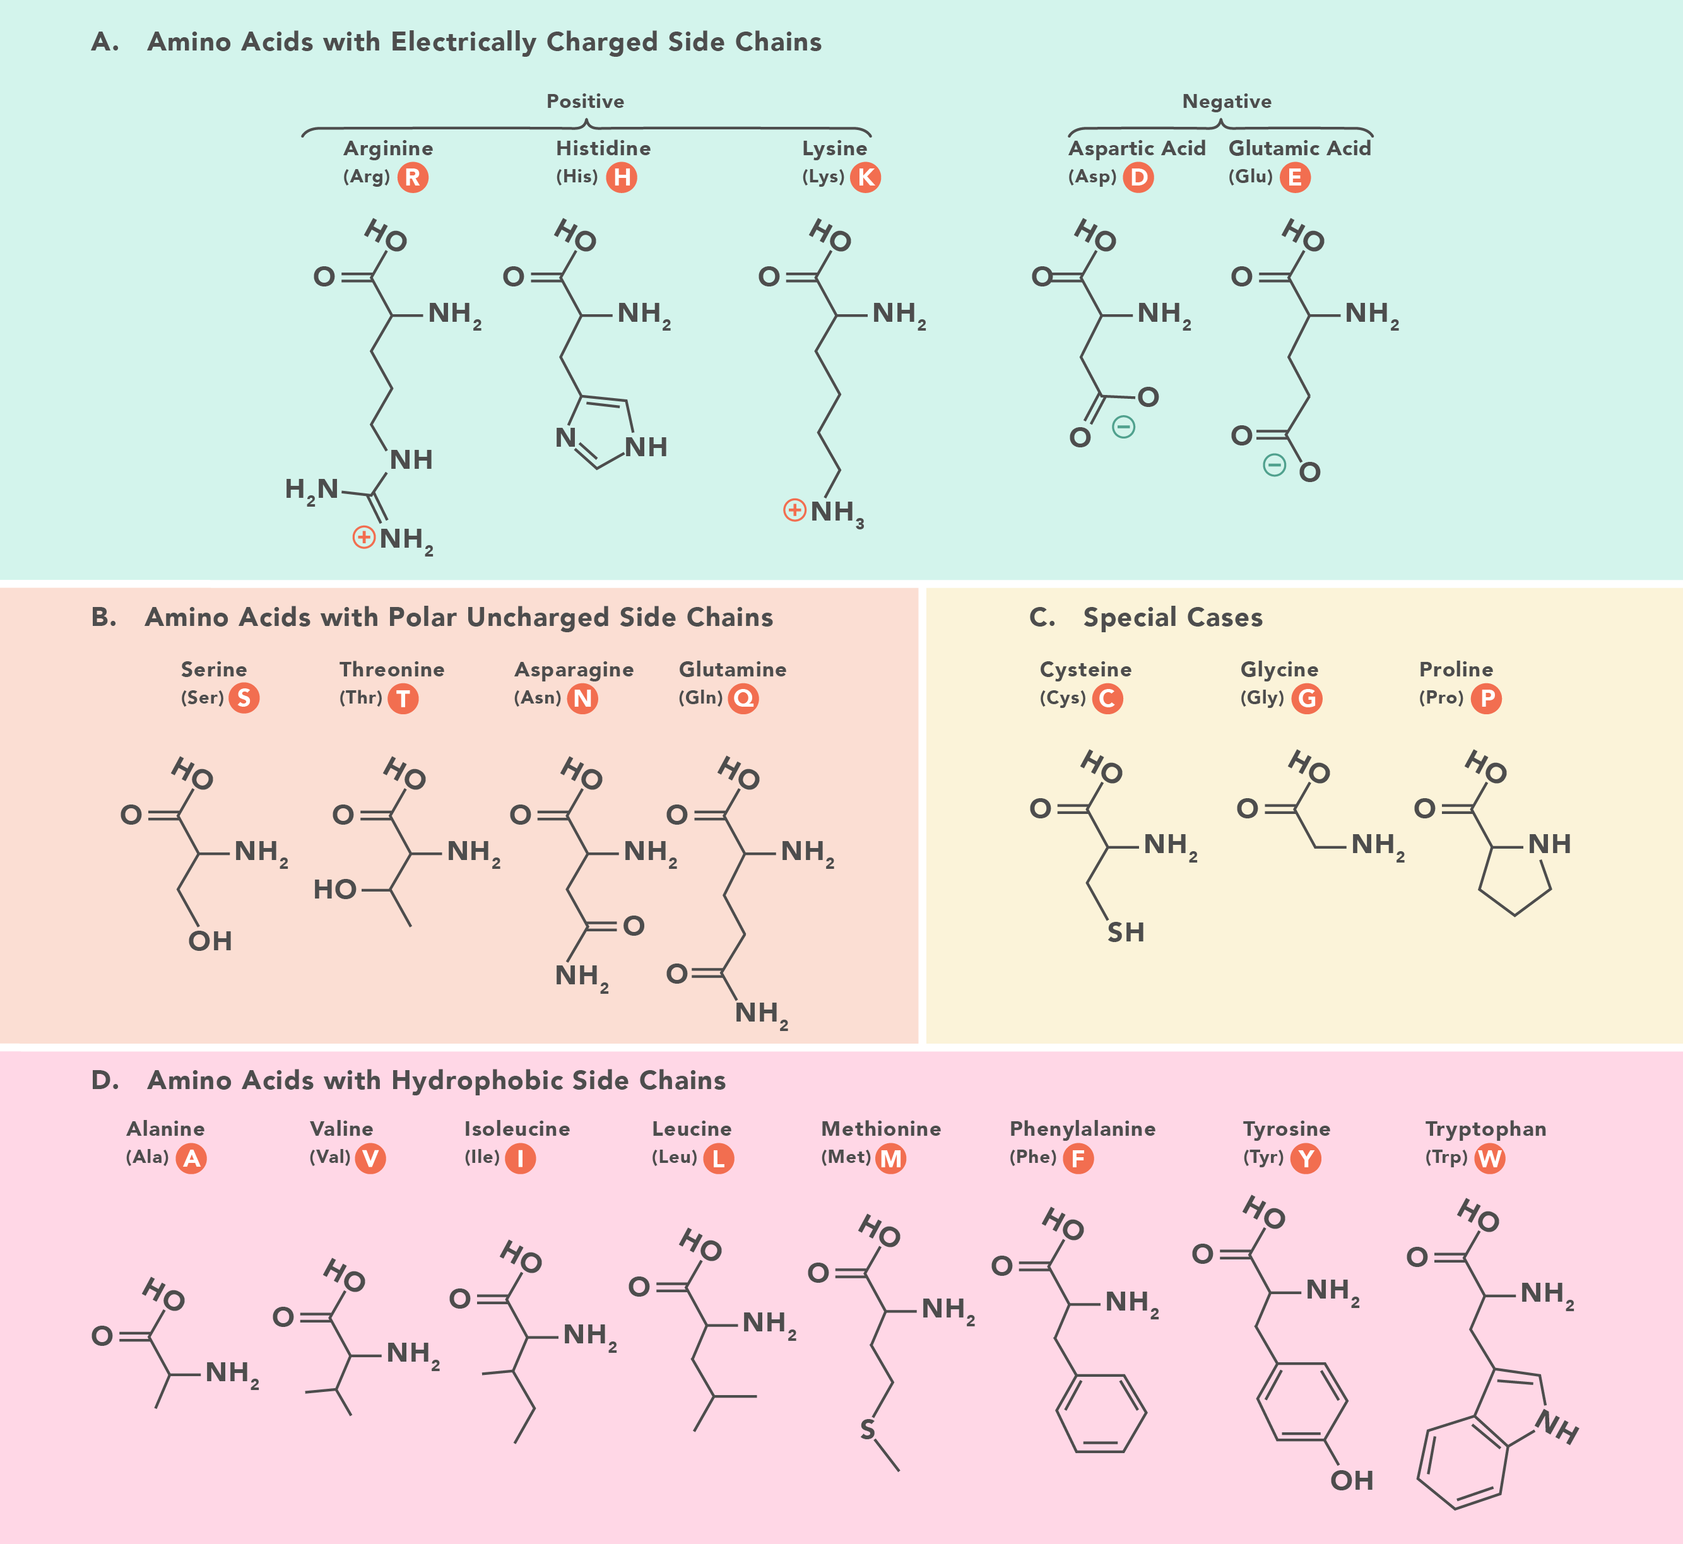

Slide 31
From this table, we can see that the genetic code is degenerate, in that most amino acids can be specified by more than one codon.
The degeneracy of the genetic code means that we can deduce the protein sequence from a DNA or RNA sequence, but you cannot unambiguously deduce a nucleic acid sequence from a protein sequence.

Slide 32
The Tree of Life and Evolution
The integrity of the genetic information in DNA is carefully protected, and without this protection life would soon disintegrate.
Nevertheless, errors inevitably arise in the genome, and these are extremely important as they also provide the genetic variation on which natural selection and evolution can act.

Slide 33
Over very long periods of time some of those changes that do not prove to cause their carriers a disadvantage are likely to spread and eventually occur in all genomes of the species.
In this way species can evolve, and ultimately they can evolve into entirely new species. It is generally thought that all existing life has evolved from a single common, very distant ancestor. The evolutionary relationship of known species to each other is commonly described as the tree of life.

Slide 34
Tree of life.
Evolution branches out like a real tree where the roots are the origin and the branches are the different groups of life form.

Slide 35
A brief survey of the basic characteristics of the major forms of life
In this context, all living organisms can be divided into two vast groups: the prokaryotes, which are further divided into the unicellular bacteria and archaea, and the eukaryotes, which include all other living organisms.
Another class of objects that contain nucleic acid instructions for their reproduction is the viruses. These have very small genomes that encode the proteins that make up the virus structure, but viruses can only replicate inside a living cell of another organism, as they hijack the cell’s biochemical machinery for replicating DNA and synthesizing proteins. Viruses may have either DNA or RNA genomes.
Although viral genes follow the basic rules by which DNA encodes RNAs and proteins, it is worth noting that some viral genomes have unusual features not commonly present in cellular genomes, such as overlapping genes, which need careful interpretation.

Slide 37
The prokaryotes are a vast group of unicellular microorganisms. Their cells are simple in structure, lacking a nucleus and other intracellular organelles such as mitochondria and chloroplasts. Taxonomically, the prokaryotes comprise two superkingdoms, or domains, called the Bacteria and the Archaea, which in evolutionary terms are as distinct from each other as both are from the rest of the living world.
Their DNA is usually in the form of a single circular chromosome (although linear chromosomes are known in prokaryotes), containing a single circular DNA molecule, and is not enclosed in a nucleus.
In favorable growing conditions, prokaryotes reproduce rapidly by simple cell division, replicating their DNA at each division so that each new cell receives a complete set of genetic instructions.

Slide 38
All other living organisms are eukaryotes and belong to the domain Eukarya. All animals, plants, fungi, algae, and protozoa are eukaryotes. The eukaryotes include both multicellular and unicellular organisms.
Unicellular eukaryotes widely used as model organisms for genetic and genomic studies are the yeasts and unicellular algae such as Chlamydomonas.
Eukaryotic cells are larger and more complicated than those of prokaryotes. The DNA is contained inside a nucleus, and is highly packaged with histones and other proteins into a number of linear chromosomes, ranging from two to hundreds depending on the organism.

Slide 39
Humans have 46 chromosomes in their body cells (made up of two sets of 23 chromosomes inherited from each parent), the fruit fly Drosophila has 8, petunias have 14, while the king crab has 208.
There appears to be no particular reason why the DNA is divided up into such different numbers of chromosomes in different organisms; the actual numbers of genes in the genomes of multicellular organisms are much more similar and vary between 20,000 and 30,000 for those organisms whose genomes have been sequenced to date.

Slide 40
Eukaryotic cells are highly compartmentalized, with different functions being carried out in specialized organelles.
Two of these are of particular interest here, as they contain their own small genomes. Mitochondria contain the components for the process of energy generation by aerobic respiration, and chloroplasts contain the molecular components for photosynthesis in plant and algal cells.
These two organelles are believed to be the relics of prokaryotic organisms engulfed by the ancestors of eukaryotic cells and still retain small DNA genomes of their own— mitochondrial DNA (mitDNA) and chloroplast DNA—and the protein machinery to transcribe and translate them. These genomes encode some of the proteins specific to mitochondria and chloroplasts, but most of their proteins are now encoded by genes in the eukaryotic cell nucleus.

Slide 41
Nucleic acid sequences can change as a result of mutation
There are a number of occasions, such as DNA replication, when the genomic DNA is actively involved in processes that leave it vulnerable to damage. Sometimes this damage will be on a large scale, such as the duplication of whole genes, but often it involves just a single base being incorrectly replicated.
The general term used to describe such damage is mutation. Depending on which part of the DNA sequence is affected, mutations can have a drastic effect on the information encoded, leading to changes in the sequence of encoded proteins, or the loss of control signals.

Slide 42
Genes can be rendered inactive or proteins dysfunctional, although mutations can also have beneficial effects. In organisms that use sexual reproduction, unless the DNA affected is in a germ cell, the DNA will not be used to generate the genomes of future generations, and so will only affect the organism in which the damage occurred.
In such cases, the organism might suffer, especially if the mutation causes uncontrolled cell growth and division, as happens in tumors.
The alternative is that the mutation is transmitted through to the next generation, in which case it has a chance to eventually become part of the normal genome of the species.

